Slide 1
Time and Global States
Distributed Computer Systems
CT024-3-3-DCOMS and Version 0416

Slide 2
Topic & Structure of The Lesson
Global time
Local time
Clock synchronization

Slide 3
Learning Outcomes
At the end of this topic, You should be able to
Understand the global time
Understand the concept of distributed time
Explain about the synchronization clock

Slide 4
Key Terms You Must Be Able To Use
If you have mastered this topic, you should be able to use the following terms correctly in your assignments and exams:
Global time
Distributed time
Physical clocks
Logical clocks

Slide 5
Lack of Global Time in DS
It is impossible to guarantee that physical clocks run at the same frequency
Lack of global time, can cause problems
Example: UNIX make
Edit output.c at a client
output.o is at a server (compile at server)
Client machine clock can be lagging behind the server machine clock

Slide 6
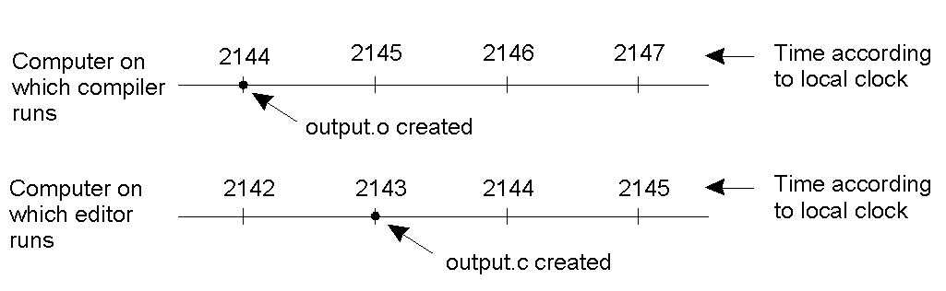
Lack of Global Time – Example
When each machine has its own clock, an event that occurred after another event may nevertheless be assigned an earlier time.

Slide 7
Why global timing?
Suppose there were a globally consistent time standard
Would be handy
Who got last seat on airplane?
Who submitted final auction bid before deadline?
Did defense move before snap?

Slide 8
Distributed Time
Premise
The notion of time is well-defined (and measurable) at each single location
But the relationship between time at different locations is unclear
Can minimize discrepancies, but never eliminate them
Reality
Stationary GPS receivers can get global time with < 1µs error
Few systems designed to use this

Slide 9
Ways to Synchronize
Send message from first base to home?
Or to a central timekeeper
How long does this message take to arrive?
Synchronize clocks before the game?
Clocks drift
million to one => 1 second in 11 days
Synchronize continuously during the game?
GPS, pulsars, etc

Slide 10
Synchronization in the real world
Real networks are asynchronous
Propagation delays are arbitrary
Real networks are unreliable
Messages don’t always arrive

Slide 11
Clock Synchronization make example
When each machine has its own clock, an event that occurred after another event may nevertheless be assigned an earlier time.
Same holds when using NFS mount
Can all clocks in a distributed system be synchronized?

Slide 12
Physical Clocks
It is impossible to guarantee that crystals in different computers all run at exactly the same frequency. This difference in time values is clock skew.
“Exact” time was computed by astronomers
The difference between two transits of the sun is termed a solar day. Divide a solar day by 24*60*60 yields a solar second.
However, the earth is slowing! (35 days less in a year over 300 million years)
There are also short-term variations caused by turbulence deep in the earth’s core.
A large number of days (n) were used used to the average day length, then dividing by 86,400 to determine the mean solar second.

Slide 13
Logical Clocks
For a certain class of algorithms, it is the internal consistency of the clocks that matters. The convention in these algorithms is to speak of logical clocks.
Lamport showed clock synchronization need not be absolute. What is important is that all processes agree on the order in which events occur.

Slide 14
Lamport Timestamps [1978]
Lamport defined a relation ”happens before”. a → b ‘a happens before b’.
Happens before is observable in two situations:
If a and b are events in the same process, and a occurs before b, then a → b is true.
If a is the event of a message being sent by one process, and b is the event of the message being received by another process, then a → b is also true.

Slide 15
Summary
It is impossible to guarantee that physical clocks run at the same frequency
The notion of time is well-defined (and measurable) at each single location
Real networks are asynchronous
Real networks are unreliable

Slide 16
Question and answer session
Q & A

Slide 17
What we will cover next
Web Services

